Slide 1
Secure Software Design and Development (Part II: Seven Touchpoints for Software Security)
Chapter 5. Introduction to Software Security Touchpoints
Book: Software Security: Building Security In, 1st Edition by Gary McGraw

Slide 2
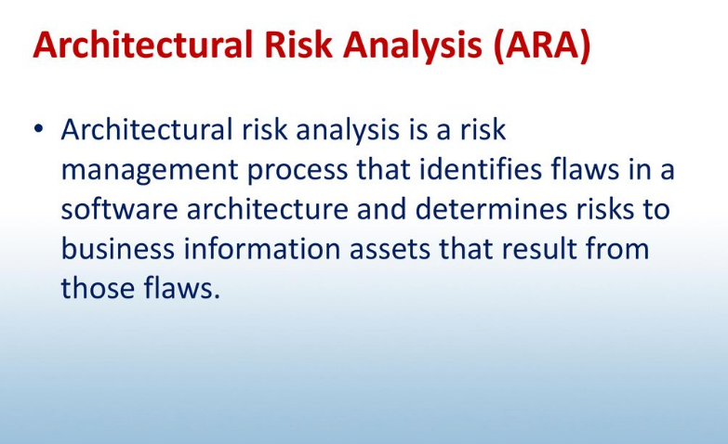
Architectural risk Analysis

Slide 3
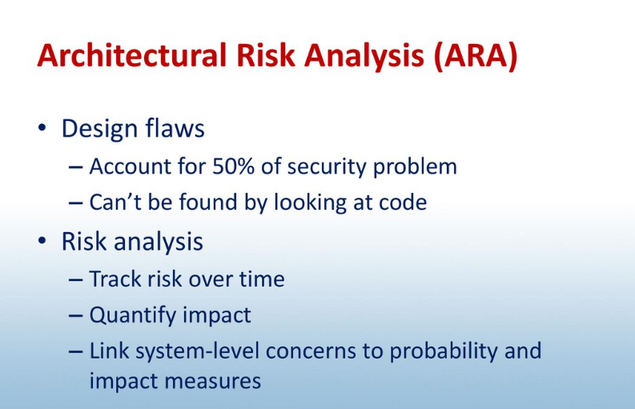
Architectural risk Analysis

Slide 4
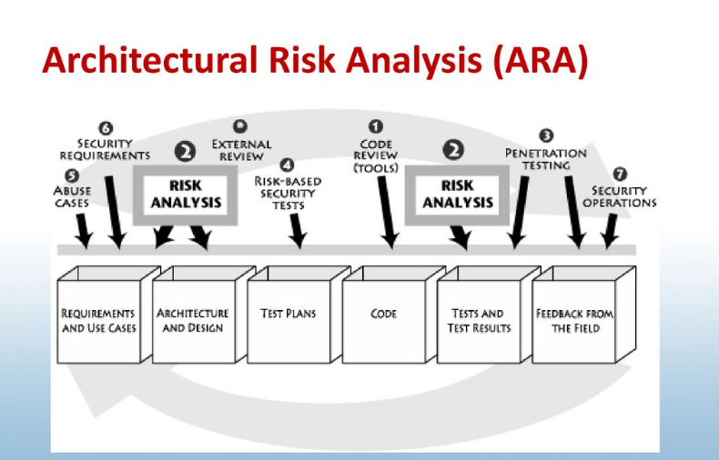
Architectural risk Analysis

Slide 5
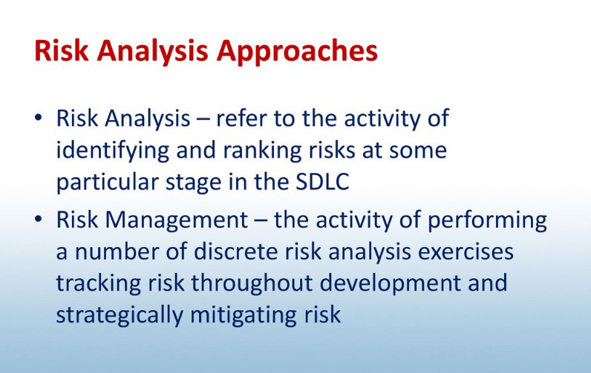
Architectural risk Analysis

Slide 6
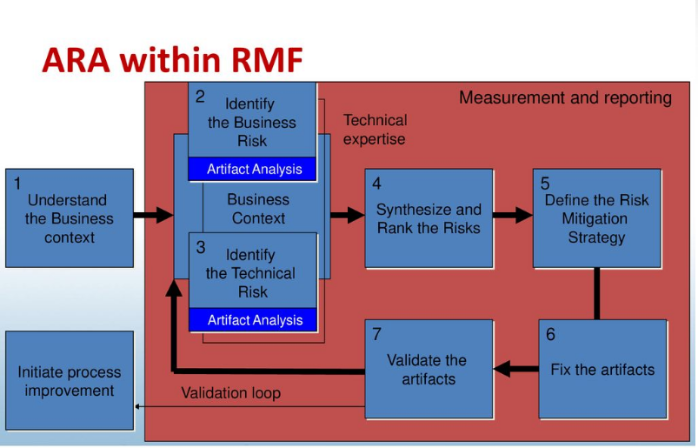
Architectural risk Analysis

Slide 7
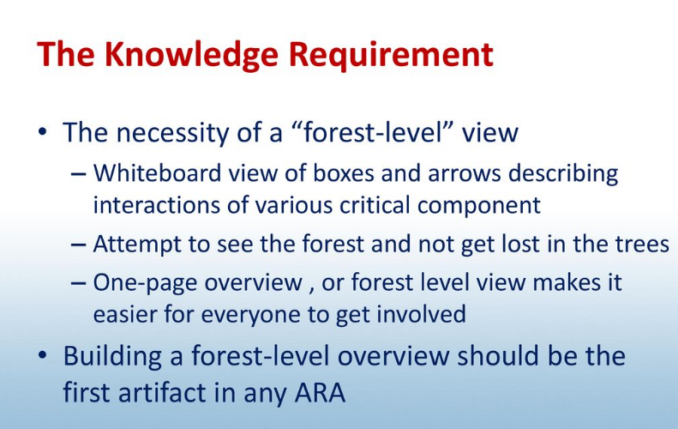
Architectural risk Analysis

Slide 8
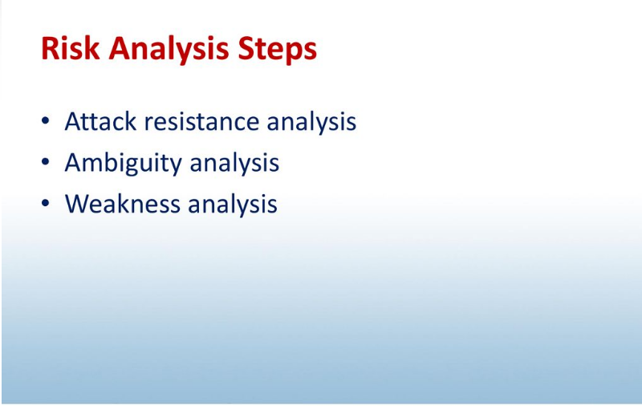
Architectural risk Analysis

Slide 9
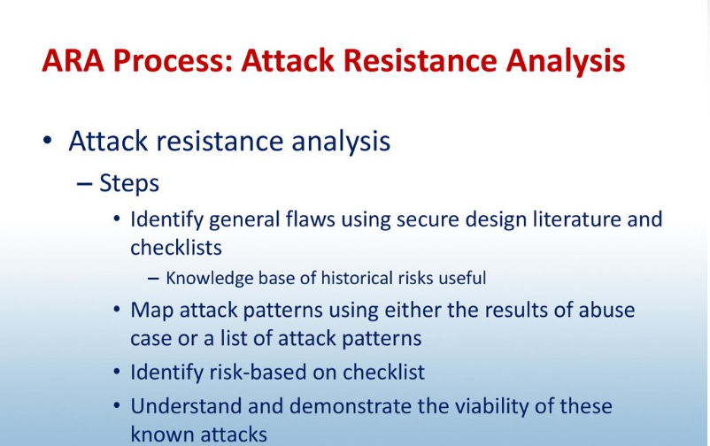
Architectural risk Analysis

Slide 10
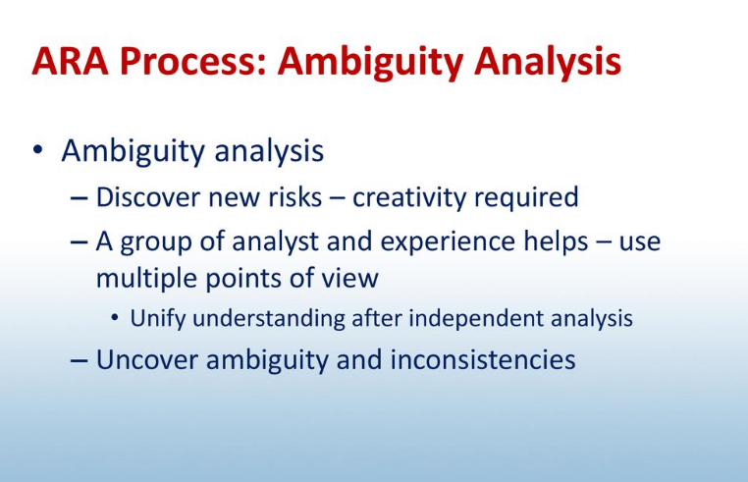
Architectural risk Analysis

Slide 11
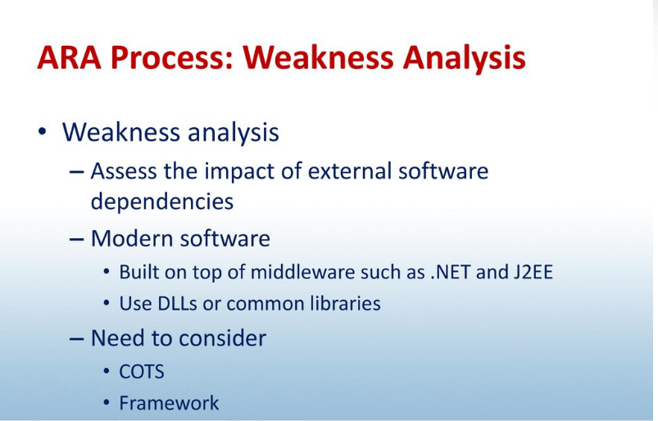
Architectural risk Analysis

Slide 12
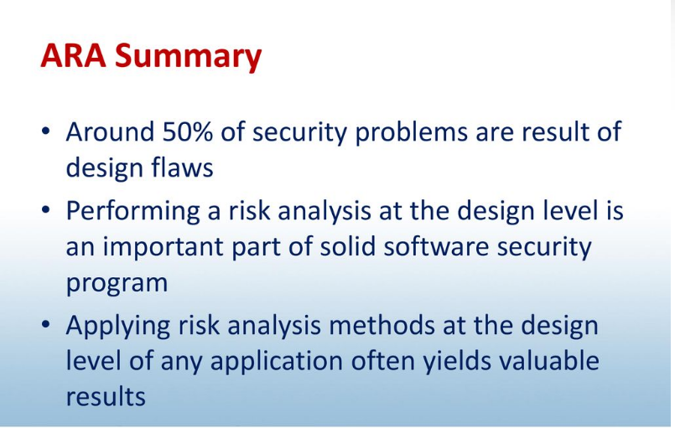
Architectural risk Analysis

